Slide 1
Stock price prediction
Jyoti Prakash Behura
20BCE7355

Slide 2
CONTENTS
Introduction
Related Work
LSTM
Methodology
Summary

Slide 3
INTRODUCTION
The stock market is known for its volatility, and predicting stock prices can be a challenging task. In this file, we explore the use of LSTM, a deep learning paradigm, to overcome the challenges of predicting stock prices. We discuss how LSTM can learn long-term dependencies in data to make accurate predictions and how it differs from other methods of stock price prediction. Additionally, we touch upon the limitations of this method and its potential applications in the financial market.

Slide 4
Related work
RautSushrut et al. proposed using supervised learning classifiers to estimate stock price movement based on financial index data and determining their capabilities
The CNN-LSTM method was used by Lu et al. to predict the Shanghai Index's close price for the following day (000001).
Jordan Prosky et al. recommended using sentiment analysis to stock prediction using CNN approaches and their use in predicting stock prices.
Using a hybrid deep learning methodology, Li et al. [8] predicted the close price of two independent data sets, JQData and Pingan Bank.Finding the best features from the supplied data was CNN's primary goal. The CNN-LSTM model's output is used as an input by the LSTM model, which then performs calculations to forecast stock price and adjusts its attention mechanism to make it more scalable. SVM, LSTM, and GRU findings were used to analyse the CNN-LSTM model's experiment results.

Slide 5
Long short-term memory
It is a unique kind of RNN that uses memory cells to store significant information over time.

Slide 6
WHY LSTM?
excellent method for learning interdependent sequences
LSTMs are much less susceptible to the vanishing gradient problem
very efficient at modeling complex sequential data because they can learn high-level representations that capture the structure of the data.

Slide 7
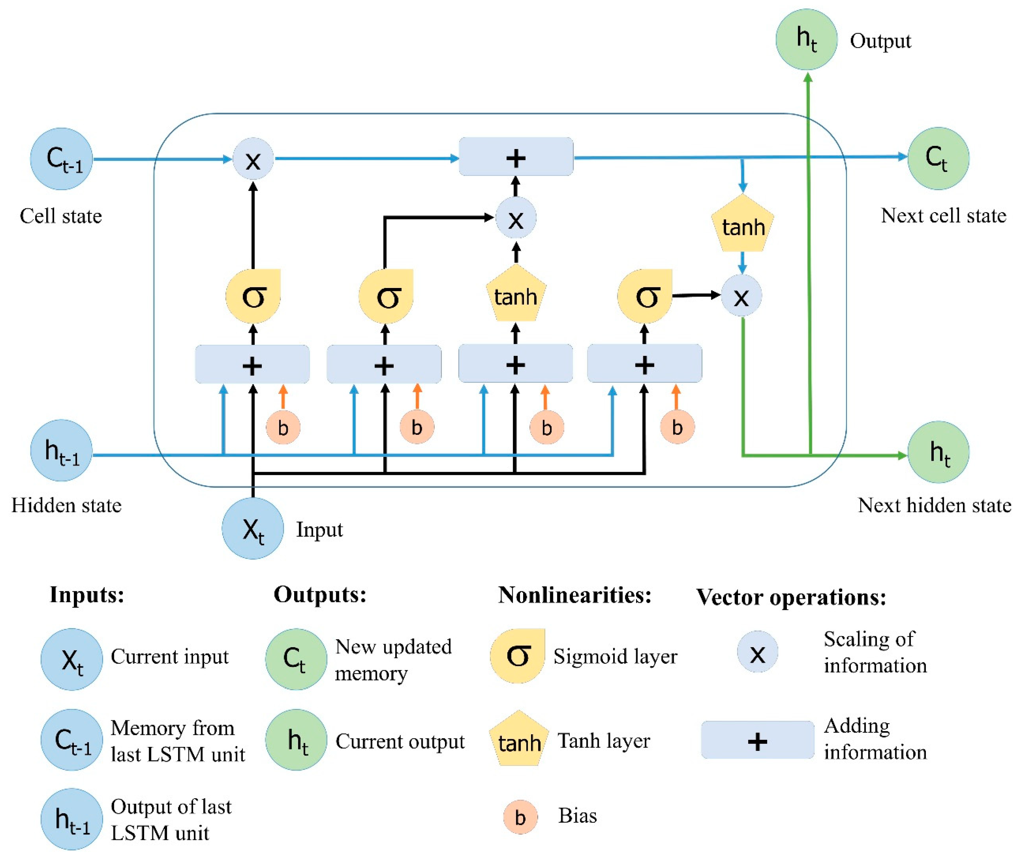
Long short-term memory

Slide 8


GATES
Forget Gate
Input Gate
Output Gate
The information that is no longer useful in the cell state is removed with the forget gate. Two inputs are fed to the gate and multiplied with weight matrices followed by the addition of bias. The resultant is passed through an activation function which gives a binary output. If for a particular cell state, the output is 0, the piece of information is forgotten and for output 1, the information is retained for future use.
The addition of useful information to the cell state is done by the input gate. First, the information is regulated using the sigmoid function and filter the values to be remembered similar to the forget gate using inputs. Then, a vector is created using tanh function that gives an output from -1 to +1, which contains all the possible values from the inputs. At last, the values of the vector and the regulated values are multiplied to obtain the useful information
The task of extracting useful information from the current cell state to be presented as output is done by the output gate. First, a vector is generated by applying tanh function on the cell. Then, the information is regulated using the sigmoid function and filter by the values to be remembered using inputs. At last, the values of the vector and the regulated values are multiplied to be sent as an output and input to the next cell.

Slide 9
Working of lstm
Forget Gate
Input Gate
Output
Gate
Output

Slide 10
Methodology

Slide 11
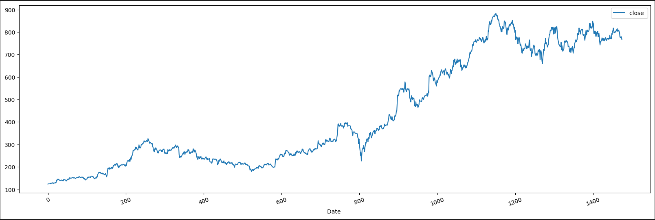
Importing Data
The TATA Consumer dataset was collected from the NSE website. We have used the TATA Consumer Stocks.
Visualizing the stock prices movement

Slide 12
Prepare The Data
Dividing the data into test and training
The last 5 days will be used as the testing data and the remaining will be the training data.
Construction of the Deep Learning LSTM Model
The output layer has one neuron because we are forecasting prices for the following day. Three hidden LSTM layers and one output layer were used. The model becomes slower as you add more neurons and layers, because there must now be many more calculations made

Slide 13
Here are a few hyperparameters
input_shape = (TimeSteps, TotalFeatures)
kernel_initializer='uniform’
activation='relu’
optimizer='adam’
Relu: A rectified linear unit (ReLU) is an activation function that introduces the property of non-linearity to a deep learning model and solves the vanishing gradients issue. "It interprets the positive part of its argument. It is one of the most popular activation functions in deep learning.
ReLU is half rectified. f(z) is zero when z is less than zero and f(z) is equal to z when z is above or equal to zero.

Slide 14
adam: aids in determining the ideal weight values for each node in the neural network. 'adam' is among the most helpful optimizers,
Other optimizers
Adagrad — Adaptive Gradient Algorithm
RMSProp
computationally efficient, has little memory requirement, invariant to diagonal rescaling of gradients, and is well suited for problems that are large in terms of data/parameters
Adam can be viewed as a combination of Adagrad, which works well on sparse gradients and RMSprop which works well in online and nonstationary settings.
Adam implements the exponential moving average of the gradients to scale the learning rate instead of a simple average as in Adagrad. It keeps an exponentially decaying average of past gradients

Slide 15
Model’s Accuracy

Slide 16
Prediction for entire dataset

Slide 17
Data Preparation for Multi Step LSTM
setting FutureTimeSteps=5, establishes that we want to forecast prices for the next five days using data from the previous ten.
LSTM Multi-step model input-output visualization
the input is a 3D array of prices from the previous 10 days, and the output is an array of prices from the following 5 days.
Deep Learning Multi-Step LSTM model's construction
The dense layer now produces a value output that is equal to the FutureTimeSteps. which in this instance is 5

Slide 18
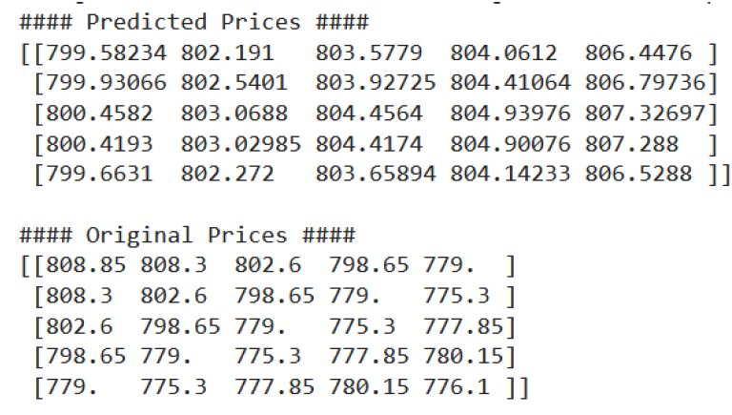
Multi step lstm model

Slide 19
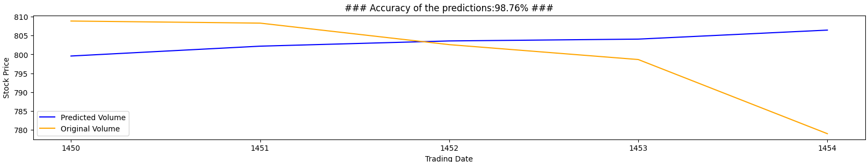
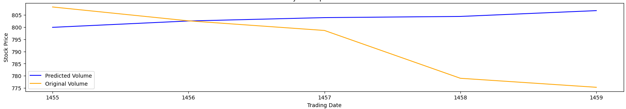
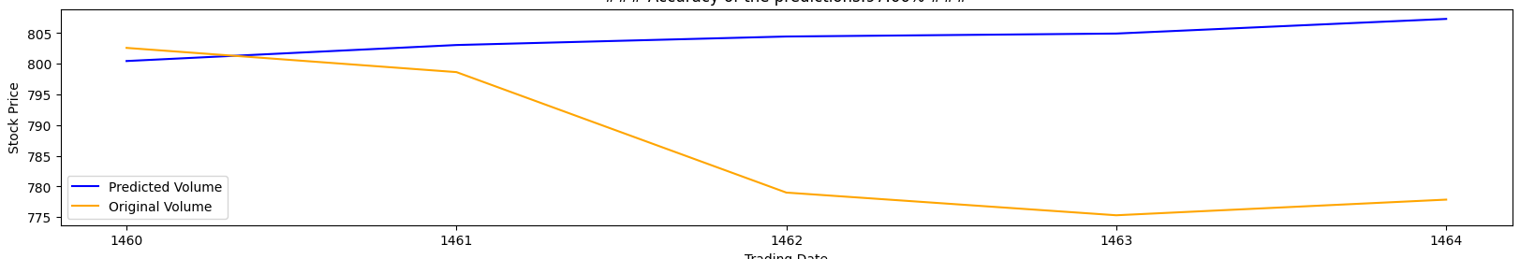
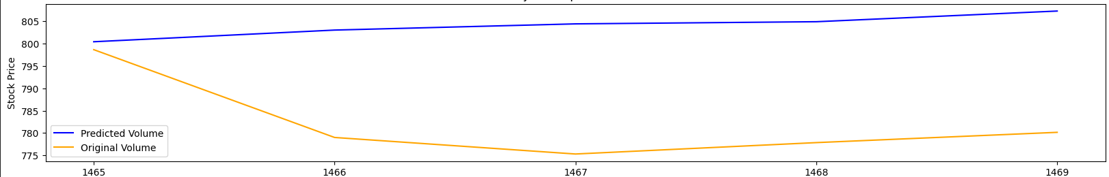
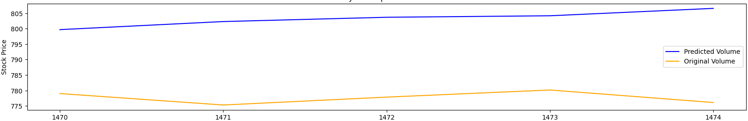
Accuracy
I Phase
(98.76%)
II Phase
(98.19%)
III Phase
(97.66%)
IV Phase
(97. 2%)
V Phase
(96. 71%)

Slide 20
Results and future scope
Result
The algorithm had an accuracy of 99.42% for measuring the model
accuracy of the testing data varied from 98.76 to 96.71%.
Training accuracy can also be improved by altering how missing data is handled, i.e., by substituting running averages or median of a specified range of data for null values.
Future Scope
Multiple variables could be considered
External influences can also be incorporated

Slide 21
Conclusion
LSTM is an effective method for learning interdependent sequences and making accurate predictions. However, it also cautions that stock markets are extremely volatile, and users should perform additional research before relying solely on this model for analysis.

Slide 22
THANK YOU

